Slide 1


Axon Healthcare Project

Slide 2
TODAY’S AGENDA
GROUP DETAILS
SUMMARY OF THE PROJECT
KPI LIST
EXCEL DASHBOARD
TABLEAU DASHBOARD
POWERBI DASHBOARD
SQL SCRIPT
SUGGESTIONS
KEY TAKE AWAYS
ABOUT AXON
HEALTHCARE

Slide 3
GROUP
DETAILS - 1
Vegi Dana Sandeep Sivaram
P Ruthvik
Suma Borannawar
Sakshi Mangesh Sonawane
Mamatha.M
Nikhil Talapaneni
Praveen Kumar Korivada

Slide 4

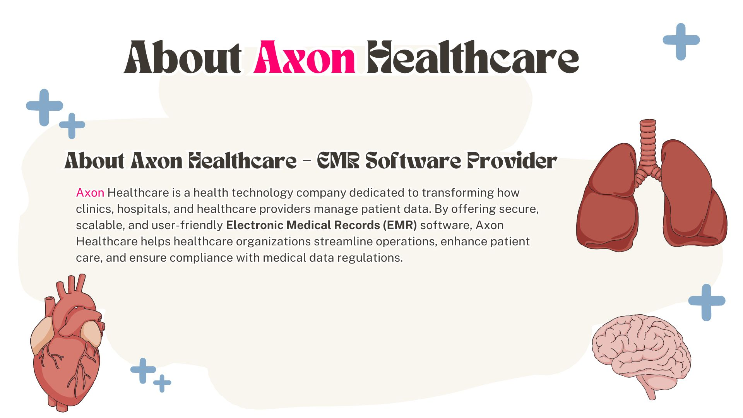




Slide 5
The Axon Healthcare Analysis Dashboard consolidates patient demographics, hospital performance, treatment costs, diagnosis trends, and lab results into a single interactive platform. It provides a holistic view of healthcare operations
To analyze diagnosis patterns, treatment cost distribution, and visit types.
To visualize patient demographics, including age, gender, and blood group distributions.
To track Hospital Name-wise and Year ,Quarter & Month-wise healthcare activity for performance evaluation.
To identify abnormal lab, result percentages for quality control and diagnostics optimization
SUMMARY OF THE PROJECT

Slide 6
Top KPI List’s
Total Patients: 10,000
Total Doctors: 10,000
Total Visits: 1,000
Average Age: 48.9 years
Follow-up Rate: 49.84%
Average Treatment Cost: 0.525 K
Abnormal Lab Results: 33.54%
Average Patients per Doctor: 10
Top 5 Diagnosed Conditions
Asthma, Diabetes, Healthy, Hypertension, Migraine (Each category visualized by count and treatment cost)
Visit Type Distribution
Breakdown by Emergency, Routine Check-up, Specialist Consultation, and Follow-up visits.
Blood Type Distribution
Count of patients by blood group (A+, A-, B+, etc.).
Doctor Performance View
Interactive filters allow tracking visits and treatments by doctor name.
Treatment & Gender Filters
Ability to filter insights by treatment type (Medication, Surgery, Physical Therapy, etc.) and gender (Male, Female, Other).
KEY PERFORMANCE INDICATORS LIST

Slide 7
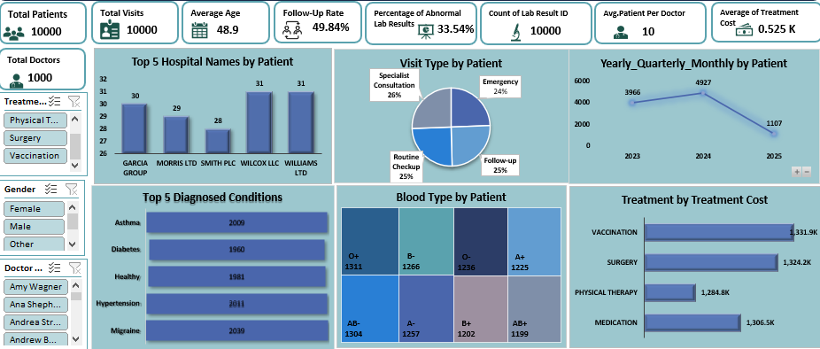
EXCEL DASHBOARD

Slide 8
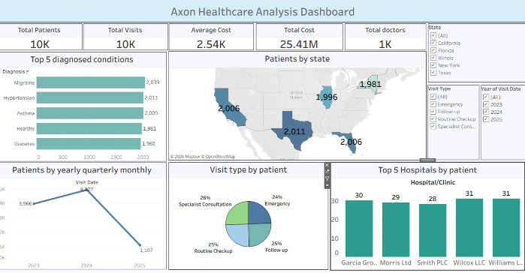
TABLEAU DASHBOARD

Slide 9
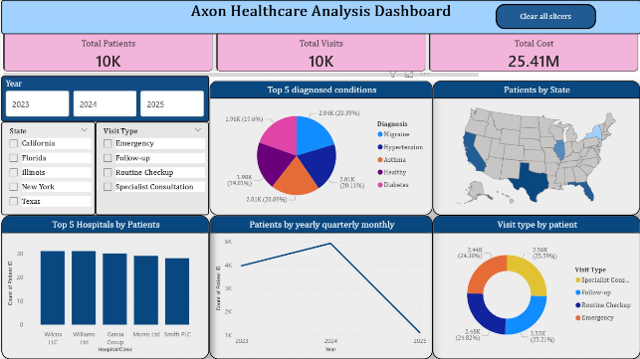
POWER BI DASHBOARD

Slide 10
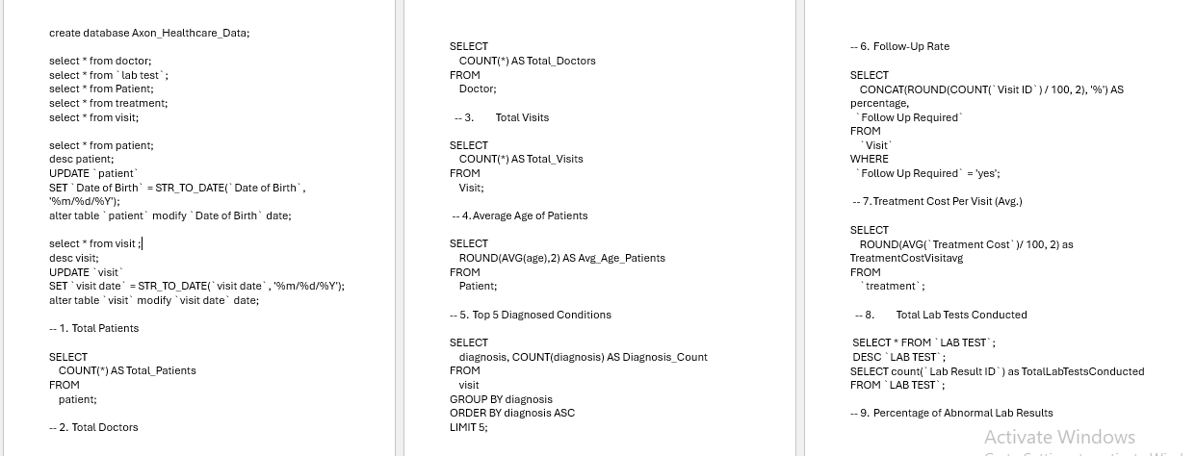
SQL SCRIPT FILE

Slide 11
SUGGESTIONS
Address 2025 Decline
Investigate causes of patient drop (competition, policy, service gaps).
Launch outreach campaigns or expand service offerings.
Enhance Preventive Care
With 33% abnormal lab results and chronic conditions dominating, preventive programs (screenings, lifestyle coaching) can reduce long-term costs.
Refine Doctor Feedback
Introduce detailed rating categories (communication, wait times, treatment effectiveness) to replace overly perfect scores.
Hospital Benchmarking
Study operational practices of Wilcox LLC and Williams Ltd to replicate success across other hospitals.
Revenue Optimization
Bundle chronic care services (e.g., diabetes + hypertension management packages).
Expand vaccination programs to increase preventive revenue streams.
Blood Bank Strategy
Use balanced blood type distribution for predictive inventory planning.
Implement AI-driven forecasting for emergencies.

Slide 12
KEY TAKEAWAYS
Patient & Visit Volume
10K patients and visits overall.
Strong growth in 2023 (3,966) and 2024 (4,927), but sharp decline in 2025 (1,107).
Impact: Indicates possible operational issues, reduced patient inflow, or external factors affecting demand.
Doctor & Patient Metrics
Average patient age: 48.9 years.
Avg. patients per doctor: 10 → manageable workload.
Follow-up rate: 49.84% → nearly half of patients return, showing good continuity of care.
Abnormal lab results: 33.54% → significant proportion requiring closer monitoring.
Hospital Performance
Top hospitals: Wilcox LLC & Williams Ltd (31 patients each), Garcia Group (30), Morris Ltd (29), Smith PLC (28).
Impact: Competitive distribution, no single hospital dominates. Benchmarking top performers could uplift others.
Visit Types
Even distribution: Specialist Consultation (26%), Routine Checkup (25%), Follow-up (25%), Emergency (24%).
Impact: Balanced service portfolio, but opportunity to strengthen chronic care follow-ups

Slide 13
Diagnosis Trends
Top conditions: Asthma (2009), Diabetes (1960), Hypertension (1911), Migraine (1900).
“Healthy” category (1981) suggests preventive visits are common.
Impact: Chronic conditions dominate → need for preventive and long-term management programs.
Treatment Costs
Surgery: 1,324.2K (highest).
Medication: 1,306.5K, Physical Therapy: 1,284.4K, Vaccination: 331.9K.
Impact: High-cost treatments (surgery, medication) drive expenditure. Preventive care could reduce reliance on costly interventions.
Blood Type Distribution
Fairly balanced across O+, B-, A+, AB-, A-, B+, AB+.
Impact: Enables predictive blood bank planning and inventory optimization.

Slide 14

Thank you

